Slide 1
Solving High-dimensional PDEs via Deep Learning
Feynman-Kac and Fokker-Planck Equations
TD Securities · QMA
Annie Zhang
Notes:
Hi everyone, I’m Annie. Today I’d like to share with you how we can use neural networks to solve PDEs — specifically Feynman-Kac and Fokker-Planck type equations that show up frequently in pricing and risk models.
The work is based on several deep learning methods applied in high-dimensional PDE settings — something that traditional solvers often struggle with.

Slide 2
Overview
Why deep learning for PDEs?
How does a DL-based PDE solver work?
Deep Galerkin Method (DGM)
Backward PDEs (Feynman-Kac) : Black-Scholes, SABR
Forward PDEs (Fokker-Planck): Black-Scholes, SABR
Other Methods: Deep BSDE, Sliced Mixture Density Network
Appendix

Slide 3
What Deep Learning-based PDE solver do?
Handle high-dimensional problems
Mesh-free
Fast pricing & Greeks after training
Acts like a closed-form engine
Much smoother than MC estimates
General and Reusable Solver Architecture
From 1D to 2D needs minimal code change
Just update objective and retrain the same network
Successfully applied to 200D+ problems in literature
“dimensions” refer to the number of state variables or model factors — like asset prices, volatilities, or interest rates

Slide 4
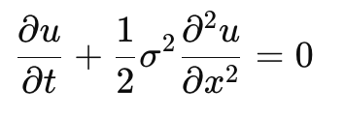
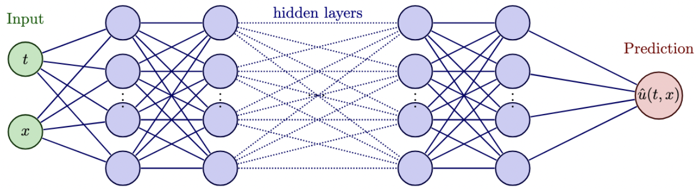
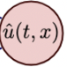
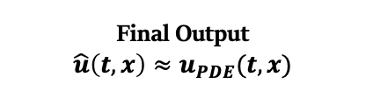
How does a DL-based PDE solver work?
📌 Example PDE: Heat Equation
Core idea: use neural network to approximate PDE solution
NN Prediction
“predict → check→ correct → repeat“
Loss Function
Training Loop: repeat until
the error is small
Check how well it fits the PDE
Calculate error* (difference from PDE)
Optimizer
Adjust the Neural Network’s parameter
Use Auto-Differentiation (PyTorch) for optimization direction
Final Output
$$\hat{u}\left(t,x\right)≈u_{PDE}(t,x)$$
Error*= how well prediction fits the PDE

Slide 5
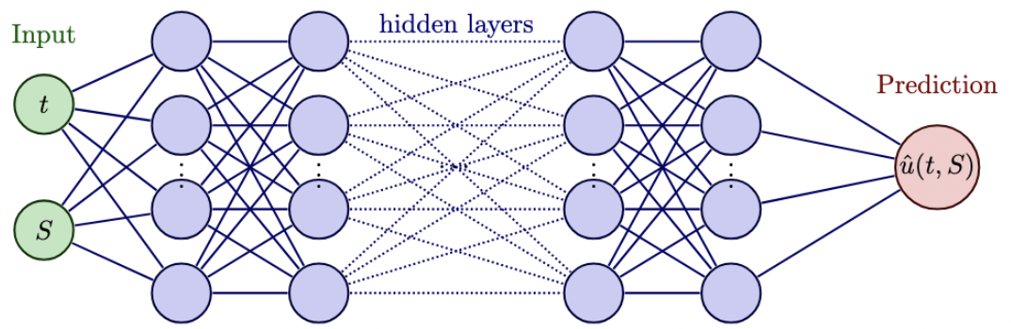
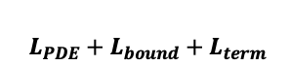
DGM – Neural Network Set Up
Forward Propagation
2
24 hidden layers
Component | DGM Design for Feynman-Kac
Input Sampler | Random mesh-free sampling over[t, S]
Neural Network | 24 hidden layers 64 neurons per layer LSTM-inspired DGM blocks
Loss Function | Tailored Loss = PDE residual + terminal payoff + boundary penalty
Optimizer | ADAM optimizer with automatic differentiation
Repeat | Train until loss converges
64 Neurons per layer
NN Prediction
1
Sampler
Random mesh-free sampling
3
4
Optimizer
Loss function
$L_{PDE}+L_{bound}+L_{term}$
Backward Propagation
Feynman-Kac
Notes:
已经见过general是怎么样的 dgm是在general的基础上做了哪些 upgrade 接下来会具体讲这些upgrade 每一个upgrade都是因为什么原因比如说怎么符合faymankac pde 所以做了这样的upgrade（设计逻辑是什么） 对应着讲

Slide 6
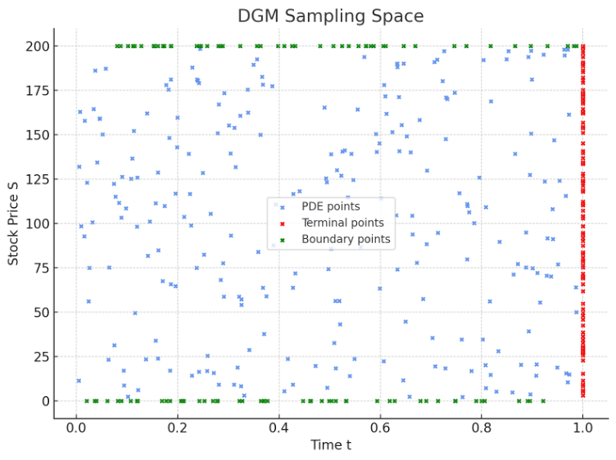
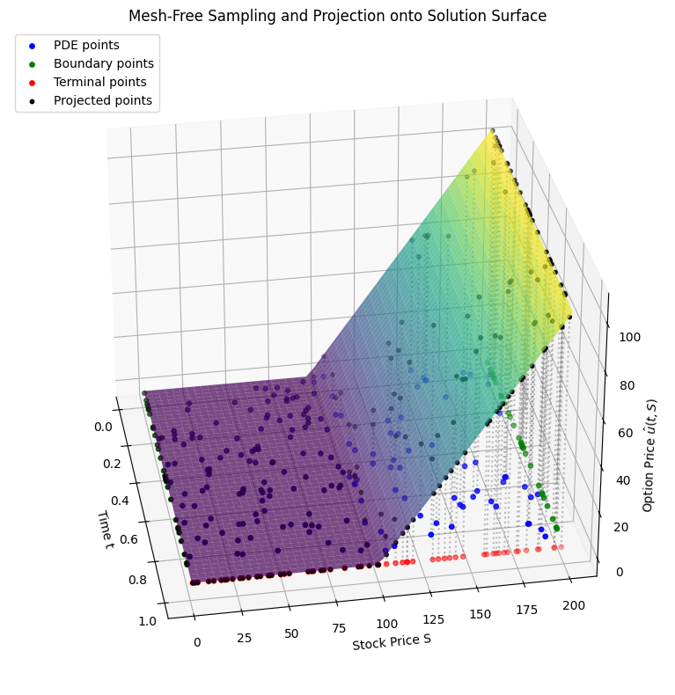
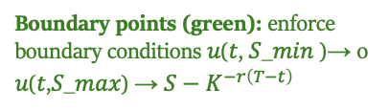
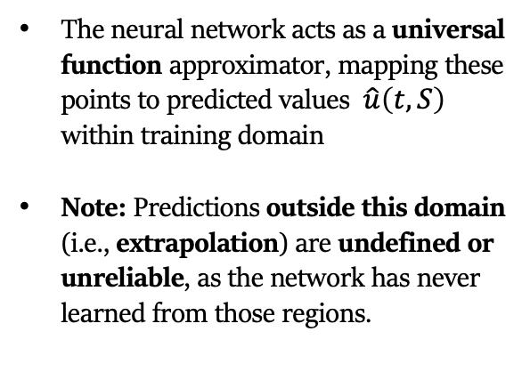
Input (t, x): Mesh-Free Sampling Space
Boundary points (green): enforce boundary conditions 𝑢(𝑡, 𝑆_𝑚𝑖𝑛 )→ 0 𝑢(𝑡,𝑆_𝑚𝑎𝑥) → $S−K^{−r\left(T−t\right)}$
The neural network acts as a universal function approximator, mapping these points to predicted values $\hat{u}\left(t, S\right)$ within training domain
Note: Predictions outside this domain (i.e., extrapolation) are undefined or unreliable, as the network has never learned from those regions.
PDE points (blue): uniformly sampled inside the domain to minimize the PDE residual.
Terminal points (red): enforce the terminal condition at t = T to be payoff MAX(S – K, 0)
Feynman-Kac

Slide 7
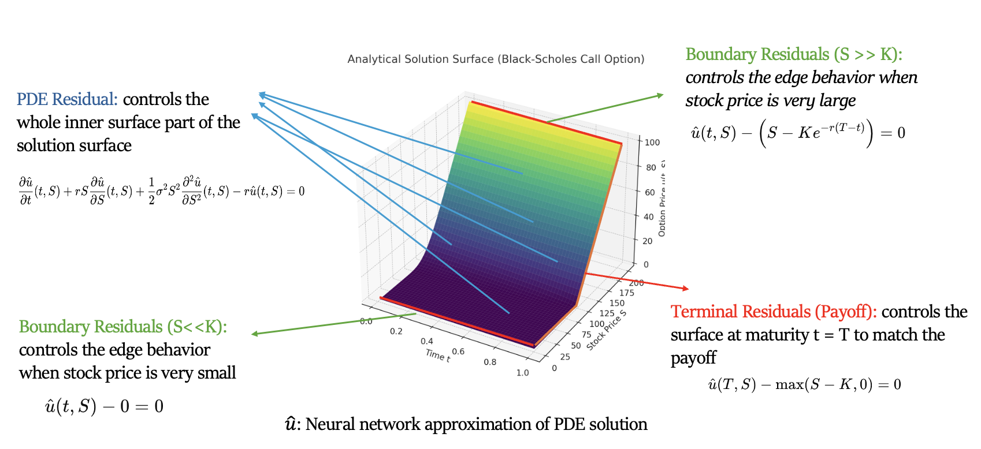
Loss function – Black Scholes
Feynman-Kac
Point Type | Where Sampled | What It Controls | Loss Term
PDE points | Interior | PDE equation / surface shape | PDE loss
Terminal points | t=T | Payoff condition at maturity | Terminal loss
Boundary points | Boundary of domain | Edge behavior (e.g., S→0) | Boundary loss

Slide 8
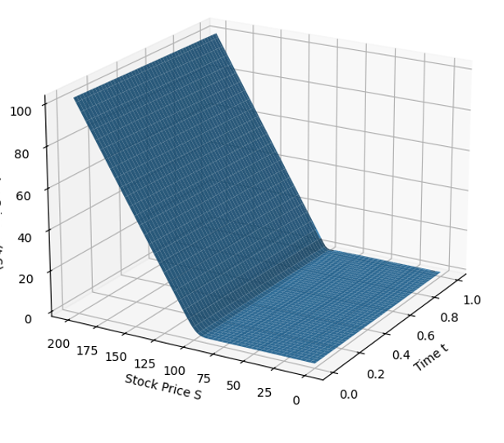
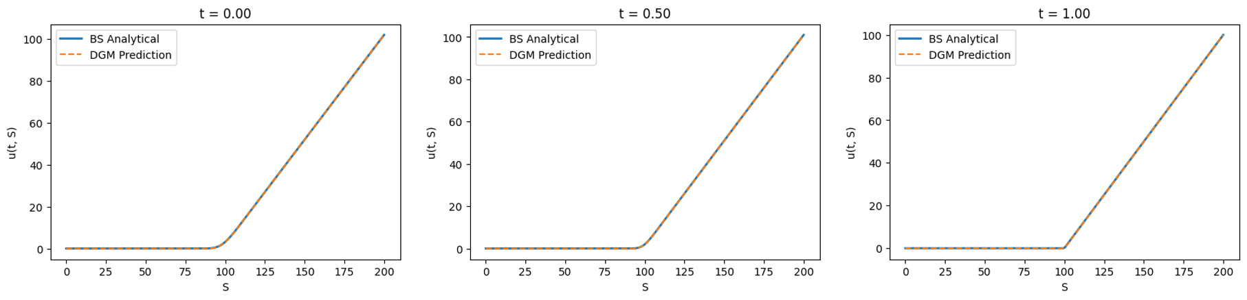
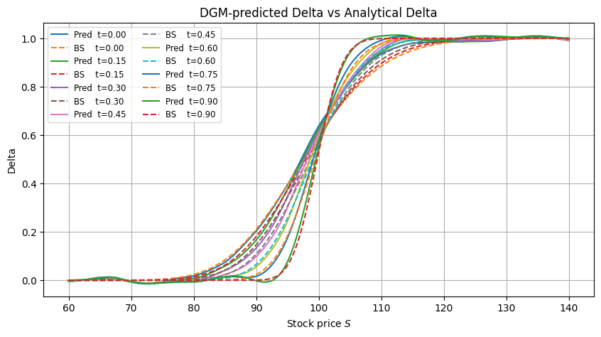
How well does DGM solve the Black–Scholes PDE? DGM accurately solves the PDE and captures both solution surface & Greeks
Fits the solution surface:
Consistent across time
Captures gradient (Greeks)
DGM Predicted Solution Surface
Feynman-Kac

Slide 9
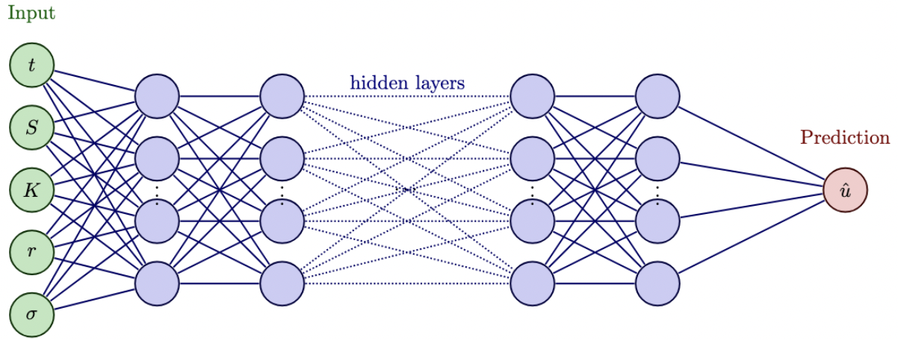
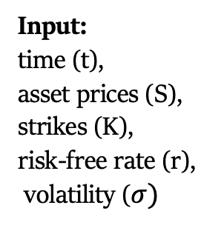
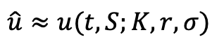
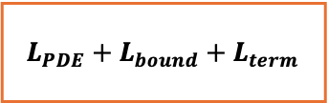
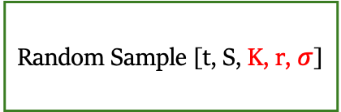
Generalized DGM Network – Black Scholes
24 Hidden Layers
Input:
time (t),
asset prices (S),
strikes (K),
risk-free rate (r),
volatility ($σ)$
64 Neurons per Layer
$$\hat{u}≈u(t, S;K,r,σ)$$
Loss
$$L_{PDE}+L_{bound}+L_{term}$$
Sampler
Optimizer
Random Sample [t, S, K, r, $σ$]
Feynman-Kac

Slide 10
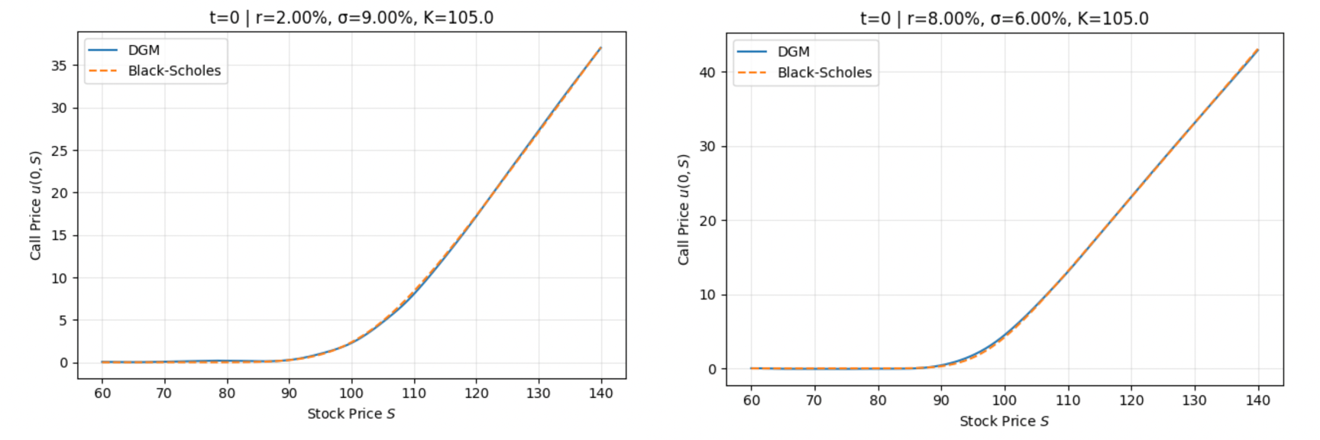
Result - Different Parameters Setting
Generalized DGM accurately predicts option prices under varying parameters.
One model, many markets — achieving amortized inference and saving retraining time.
Feynman-Kac

Slide 11
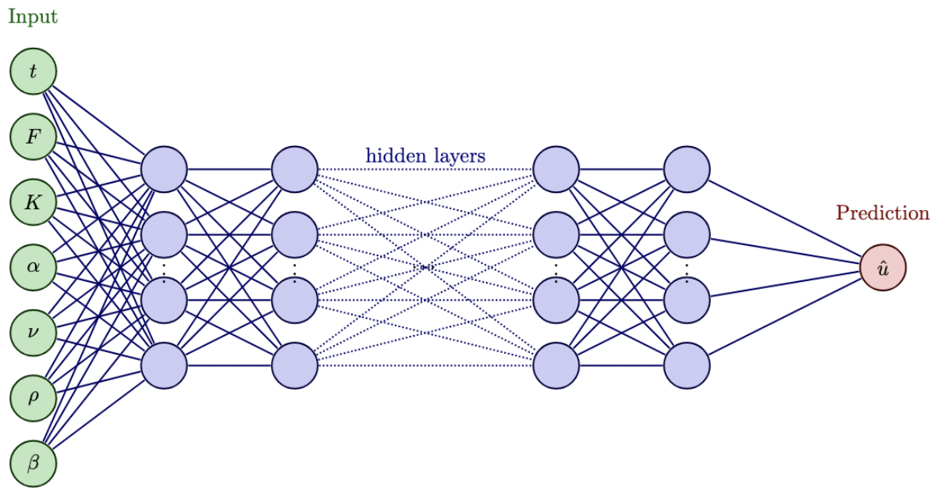
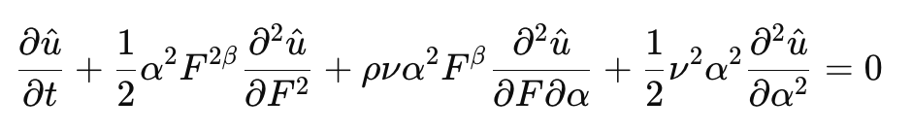
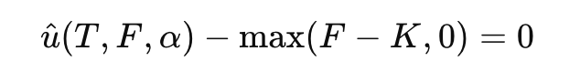
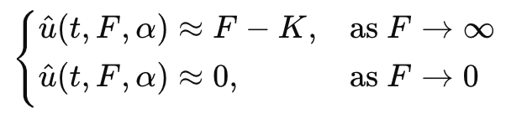
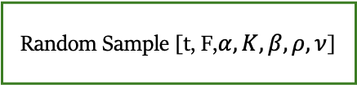
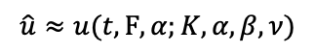
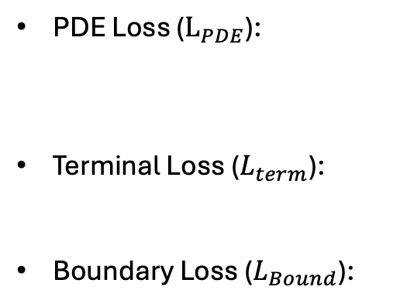
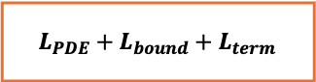
Generalized DGM Network - SABR
64 Neurons per Layer
24 Hidden Layers
$$\hat{u}≈u(t, F,α;K,α,β,ν)$$
PDE Loss ($L_{PDE}$):
Terminal Loss ($L_{term}$):
Boundary Loss ($L_{Bound}$):
Loss Function
Optimizer
$$L_{PDE}+L_{bound}+L_{term}$$
Sampler
Random Sample [t, F,$α,K,β,ρ,ν$]
Feynman-Kac

Slide 12
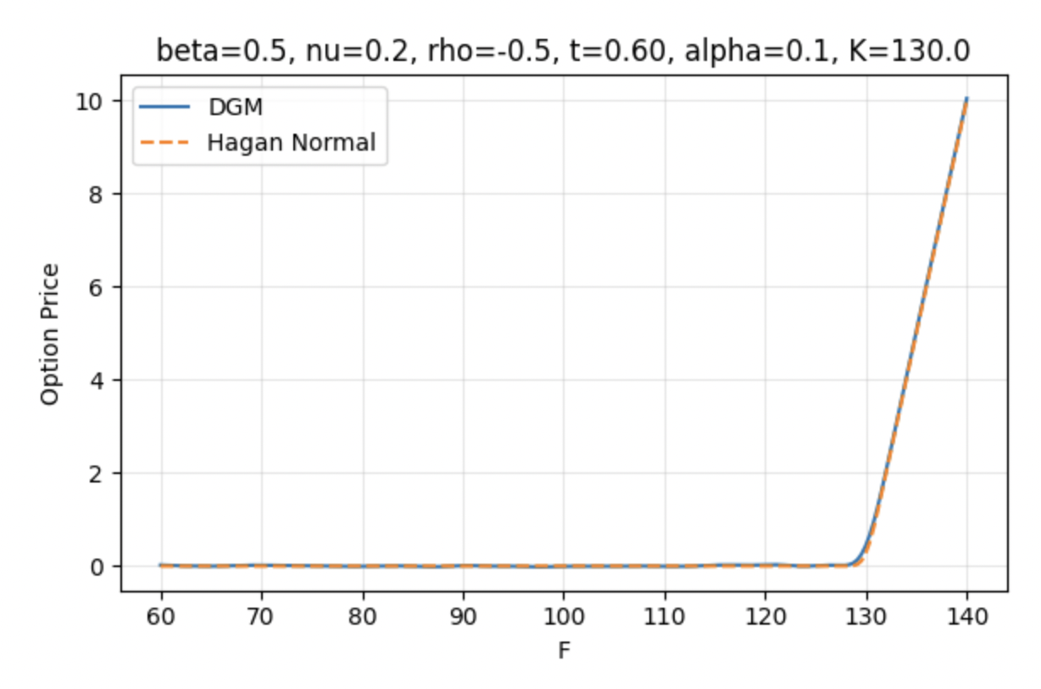
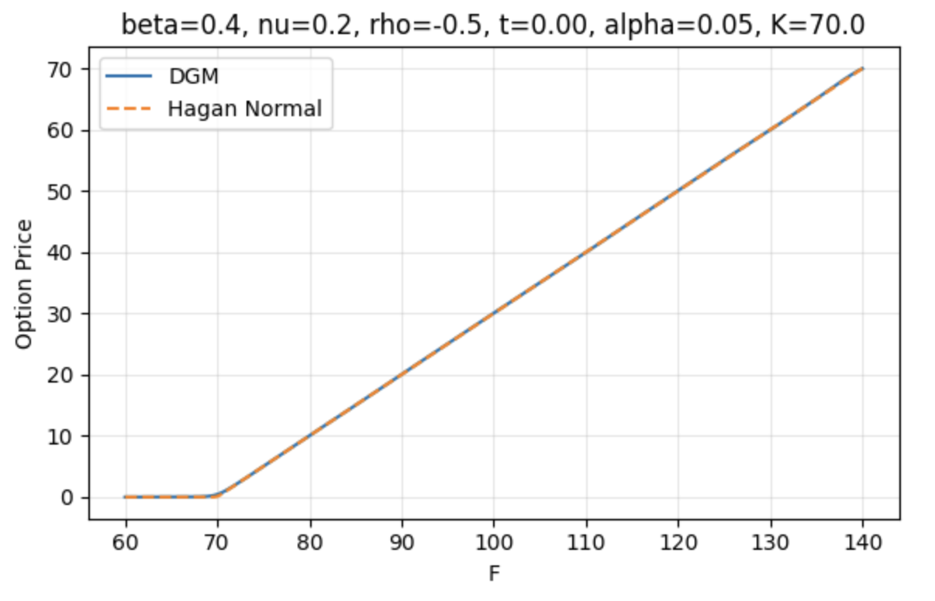
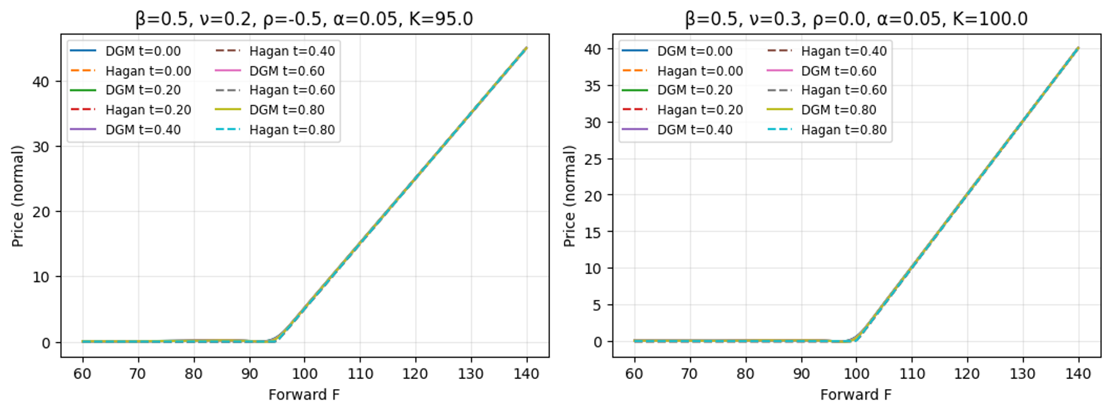
Our generalized DGM matches Hagan’s Normal formula closely under different parameter settings at t = 0.
Option prices predicted by the generalized DGM model closely match Hagan’s Normal approximation across multiple time points.

Slide 13
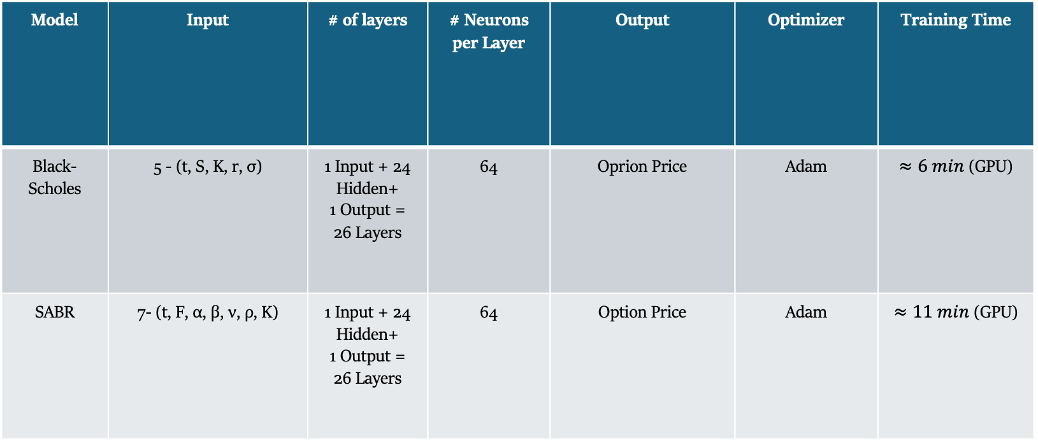
DGM - Neural Network Setting
Model | Input | # of layers | # Neurons per Layer | Output | Optimizer | Training Time
Black-Scholes | 5 - (t, S, K, r, σ) | 1 Input + 24 Hidden+ 1 Output = 26 Layers | 64 | Oprion Price | Adam | $≈6 min$ (GPU)
SABR | 7- (t, F, α, β, ν, ρ, K) | 1 Input + 24 Hidden+ 1 Output = 26 Layers | 64 | Option Price | Adam | $≈11 min$ (GPU)
Feynman-Kac

Slide 14
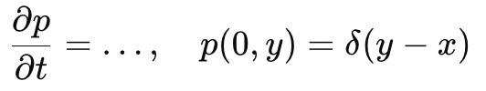
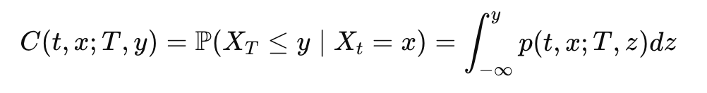
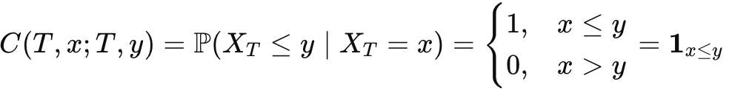
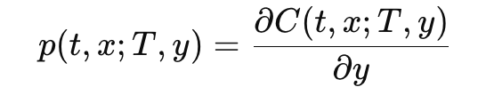
Deep Galerkin Method Fokker-Planck (Su, Tretyakov, & Newton, 2025)
Challenge – Delta Initial Condition:
Solution - Learn the CDF Instead: Train the network to approximate the cumulative distribution function (CDF)
it satisfies a Backward Kolmogorov PDE (the expectation of futures).
With terminal condition (Step Function)
Recover PDF from CDF: Obtain the transition probability density function (TPDF) by differentiating the CDF
Fokker-Planck

Slide 15
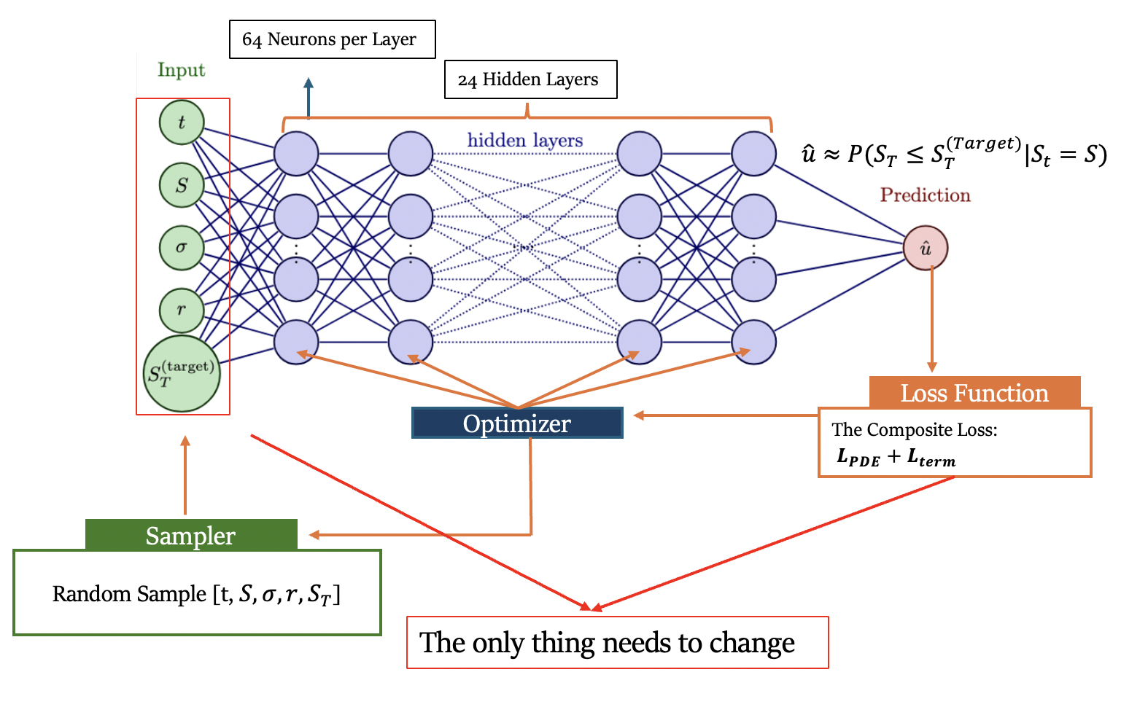
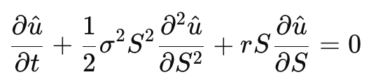
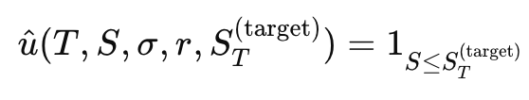
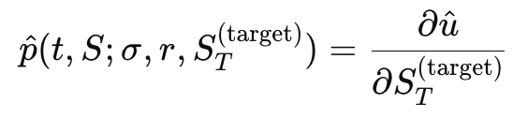
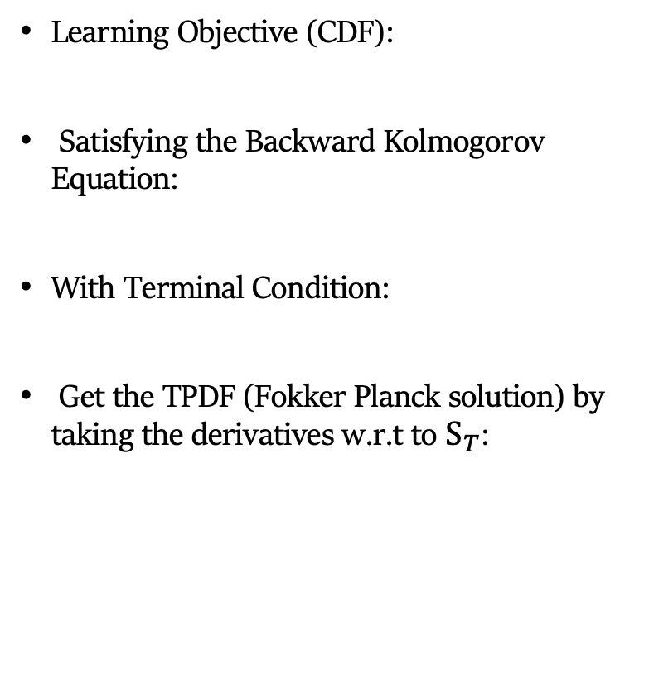
DGM Fokker Planck – Geometric Brownian Motion (BS)
Learning Objective (CDF):
Satisfying the Backward Kolmogorov Equation:
With Terminal Condition:
Get the TPDF (Fokker Planck solution) by taking the derivatives w.r.t to $S_{T}$:
Fokker-Planck

Slide 16
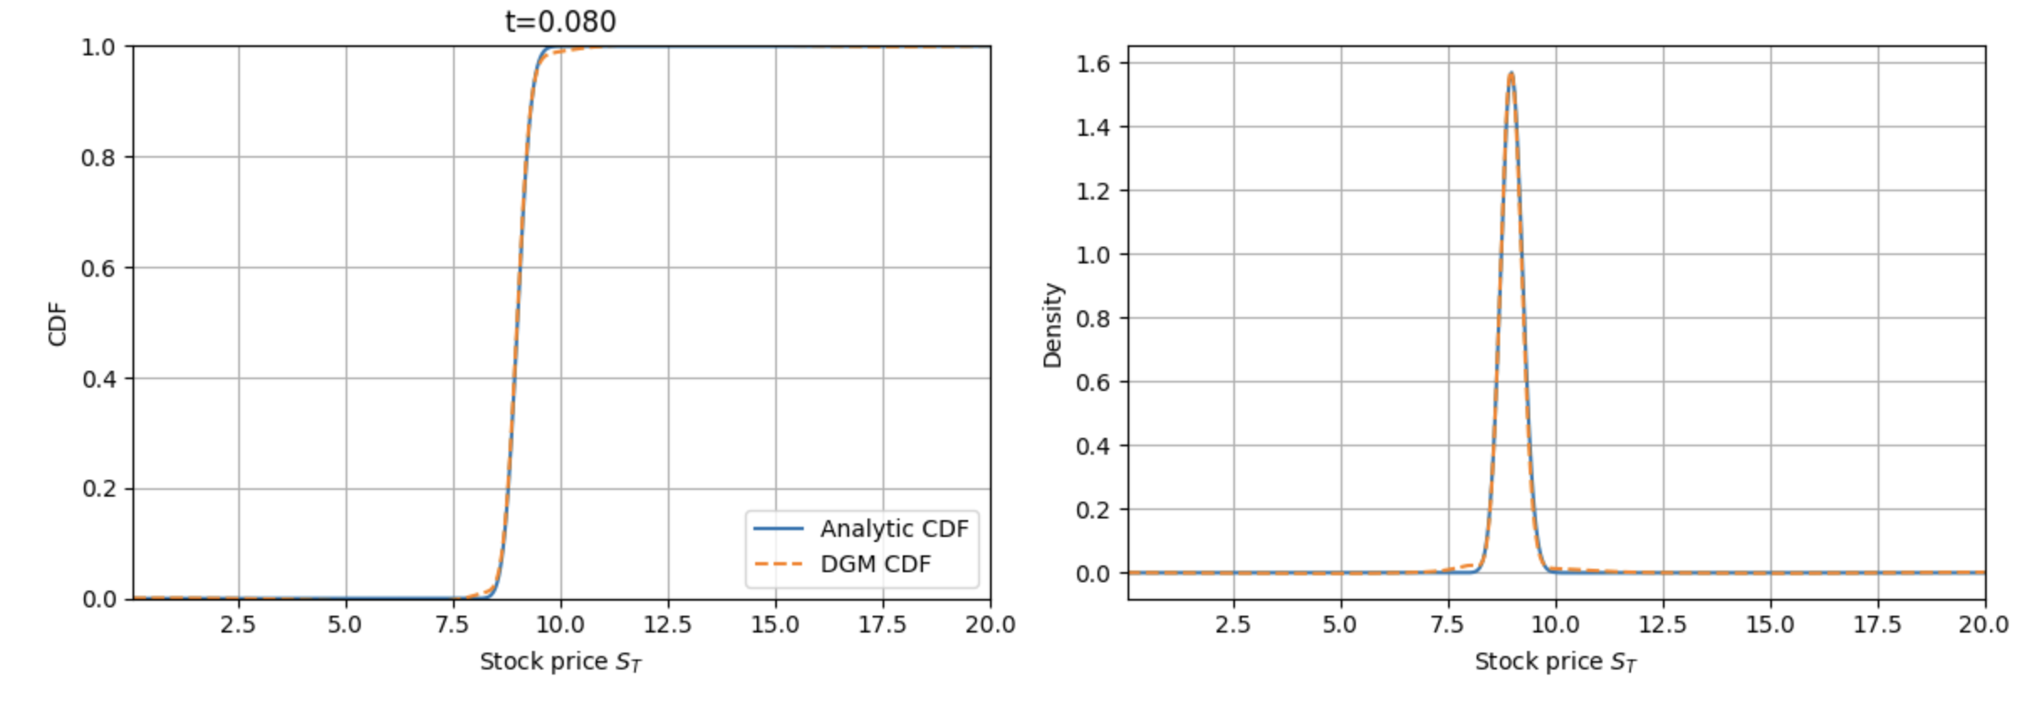
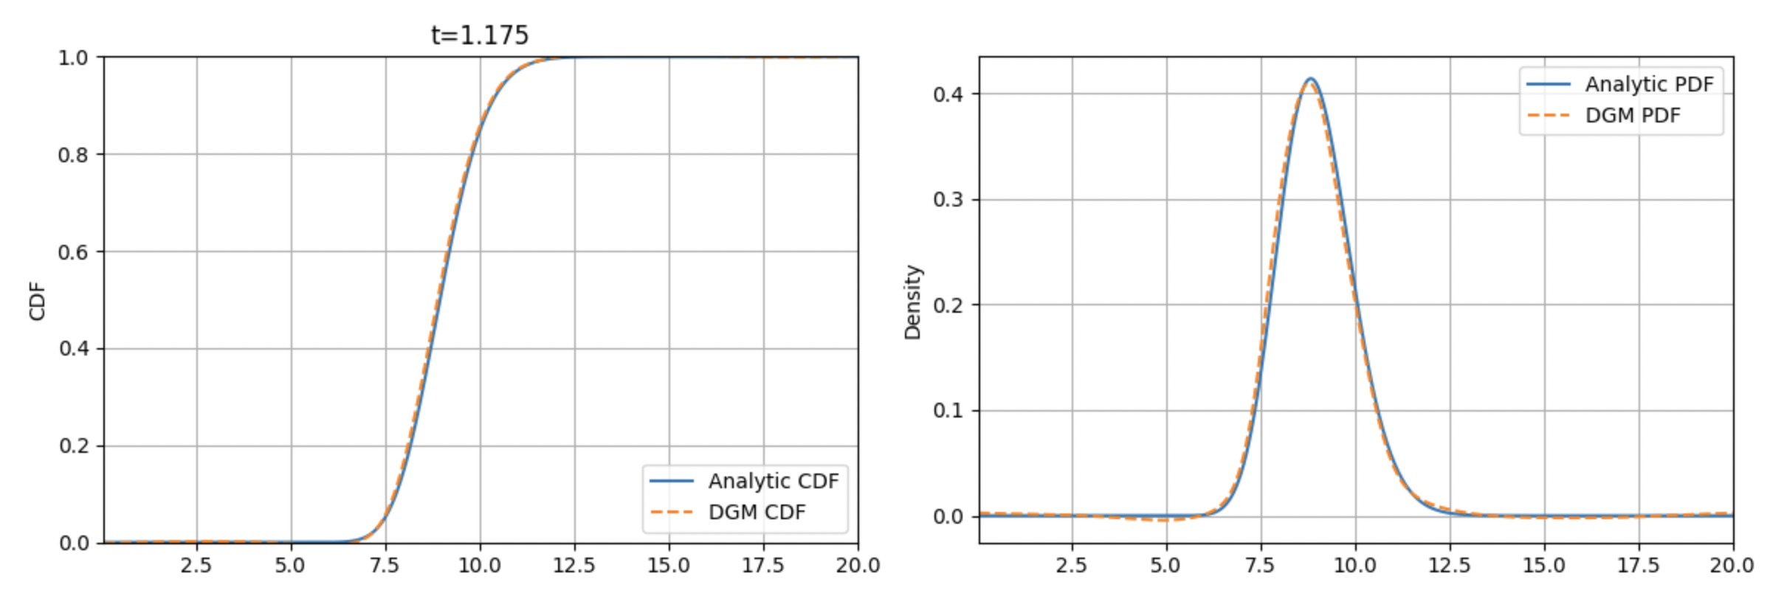
Benchmark: DGM Recovers Accurate Distributions Across Time
Learns CDF directly; obtains PDF via differentiation
Matches closely to analytical solutions at both t = 0.080 and t = 1.175
Robust across time: handles sharp peaks and smoothed tails
Captures full market uncertainty beyond simple pricing
Fokker-Planck

Slide 17
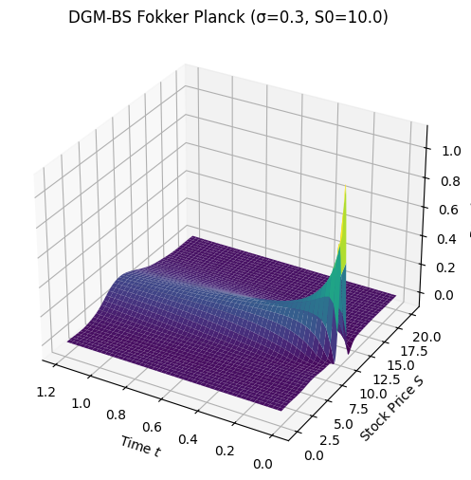
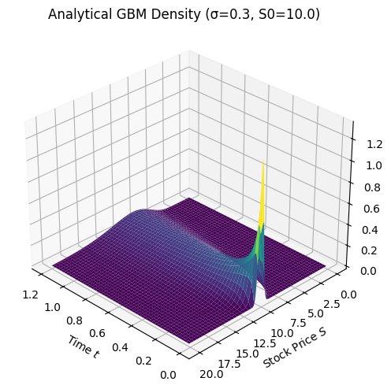
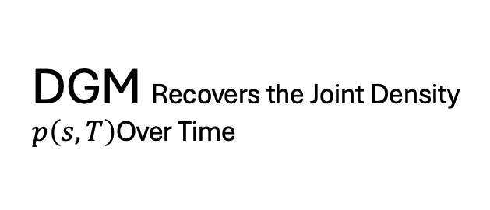
DGM Recovers the Joint Density $p\left(s,T\right)$Over Time
Accurately captures the full evolution of p(t, S)
Matches surface shape, peak dynamics, and smoothness
Fokker-Planck

Slide 18
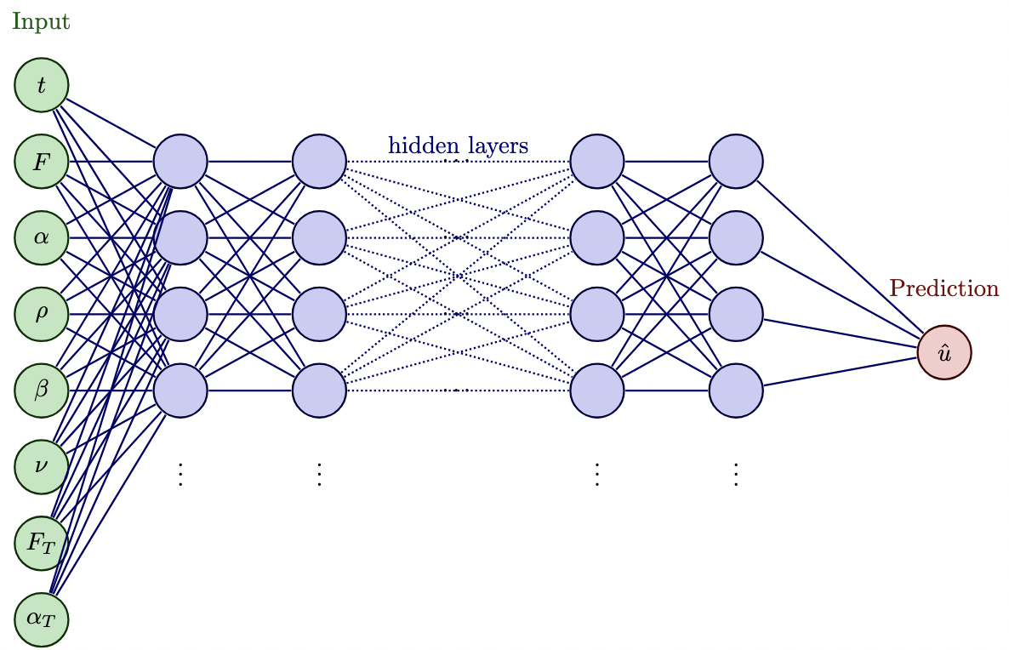
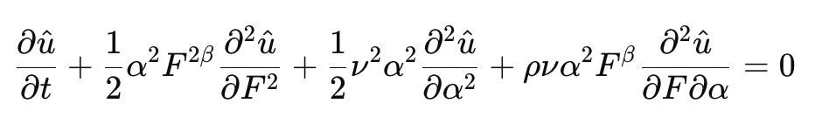
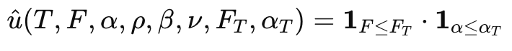
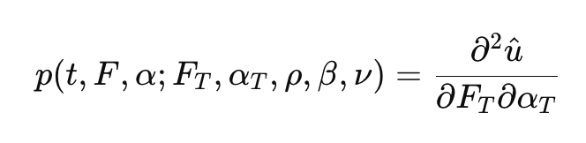


Generalized DGM Network - SABR
Learning Objective:
Backward Kolmogorov Equation for SABR:
With Terminal Condition:
Get the TPDF by taking the derivatives w.r.t. F and a:
64 Neurons per Layer
24 Hidden Layers
Optimizer
Loss Function
The Composite Loss:
$L_{PDE}+L_{bound}+L_{term}$
Sampler
Random Sample [t, F,$α,K,β,ν$] within the domain for the next iteration
Fokker-Planck

Slide 19


Learned CDF of Joint Distribution (F, ɑ)
Learned joint CDF:
Smoothly captures probability mass over 2D domain
Derivatives yield joint density via auto-differentiation
Fokker-Planck

Slide 20




Joint PDF from Auto-Differentiation
SABR’s joint PDF evolution across time
The density gradually spreads, skews, and stabilizes.
Fokker-Planck

Slide 21

Comparing with Monte Carlo Simulation
Matched closely in both shape and location of the probability mass
Fokker-Planck

Slide 22

DGM Neural Network Setting
Model | Input | # of layers | # of Neurons per Layer | Output | Optimizer | Training Time
Black-Scholes | 6-$(t,S,S_{T}, σ,r)$ | 1 Input + 24 Hidden+ 1 Output = 26 Layers | 64 | CDF Value | Adam | $≈15min$ (GPU)
SABR | 8-$(t, F,F_{T}, α, α_{T}, β, ν, ρ)$ | 1 Input + 24 Hidden+ 1 Output = 26 Layers | 64 | CDF Value | Adam | $≈30min$ (GPU)
Fokker-Planck

Slide 23
Methods Summary
Method | PDE Type | Core Idea | Generalization Power | Strengths | Limitations
Deep BSDE | Backward PDE (Feynman-Kac) | Reformulates PDE as SDE + learns gradients along forward paths | ❌ Low | Accurate value at t=0; Delta approximation via gradients | Only predicts option price at t=0; retrain for new payoffs/params; not for forward PDEs
Sliced MDN | Forward PDE (Fokker Planck) | Fits MC-sampled density at each time using Gaussian mixtures | ❌ Very Low | Smooth 1D density; interpretable; matches GBM well | Grid-based reference needed; 1 net per time step; not scalable to high dimensions
DGM (My Focus) | Backward & Forward PDEs | Learns full solution surface via residual-based loss; mesh-free | ✅ High | Solves both pricing and density PDEs; supports multi-dimensional & parametric inference | Needs deeper nets and tuning for complex models

Slide 24
Challenges
Limited Extrapolation | Poor extrapolation beyond training domain — predictions outside range can be unreliable
Training Sensitivity | Training can be sensitive to initialization and training parameters
Interpretability Issues | Neural network models lack transparency, making it difficult to understand the learned solution.
High Computational Cost | Deep architectures and large sample sizes lead to long training times and high resource demand.

Slide 25
Reference Paper
Han, J., Jentzen, A., & E, W. (2018). Solving high-dimensional partial differential equa- tions using deep learning. *Proceedings of the National Academy of Sciences*, 115(34), 8505–8510. https://doi.org/10.1073/pnas.1718942115
Sirignano, J., & Spiliopoulos, K. (2018). DGM: A deep learning algorithm for solving partial differential equations. *Journal of Computational Physics*, 375, 1339–1364. https://doi. org/10.1016/j.jcp.2018.08.029
Su, H., Tretyakov, M. V., & Newton, D. P. (2025). Deep learning of transition probability densities for stochastic asset models with applications in option pricing. *Management Science*, 71(4), 2922–2952. https://doi.org/10.1287/mnsc.2022.01448
Zhai, J., Dobson, M., & Li, Y. (2021). A deep learning method for solving Fokker- Planck equations. *Proceedings of Machine Learning Research*, 145, 568–597. https: //proceedings.mlr.press/v145/zhai21a.html

Slide 26
Q & A

Slide 27
Thank You
PDE Solver code on: http://10.175.9.240/dlpde/intro.html

Slide 28

Appendix I – Deep BSDE (Black Scholes)

Slide 29

Deep BSDE (Black-Scholes)

Slide 30

Result & Benchmark
Predicted Deltas match analytical values well across time, especially near the strike, indicating that the model correctly captures the hedging ratio Delta at each time step.

Slide 31

Result & Benchmark
The model learns accurate Deltas at each time step for hedging. (As shown previously)
These Deltas are used to simulate terminal hedge values.
We only need to train another MLP at t = 0 to output the correct initial NPV as a function of initial stock price S0, which is the option price we want at t = 0

Slide 32

Appendix II – Deep BSDE (SABR)

Slide 33

Deep BSDE (SABR)

Slide 34

Deep BSDE (SABR)

Slide 35

Deep BSDE (SABR)

Slide 36

Effect of α on SABR Pricing: Deep BSDE vs Analytical
Deep BSDE captures the pricing surface under different initial volatility α and forward price F.
When α increases (from 0.05 to 0.1), the curvature around ATM increases.

Slide 37

Appendix II - Mixture Density Network

Slide 38


Sliced Mixture Density Network
Using Monte Carlo Method sample path and approximate the density of $\hat{p_{mc}}(t, S)≈p(t,S)$
Discrete time steps as $0=t_{0}<t_{1}<…<t_{N}=T$
At each time steps, we train a Mixture Density Network $u_{n}(S)$ to approximate the density of $p(t_{n}, S)$
Optimize the network by the difference between Network Prediction and MC sampled reference point. where:
$\hat{p}$ is the predicted density from the Neural Network at t = n
$p_{MC}$is the reference density approximated by Monter Carlo sampling

Slide 39


MC Sample for Reference Points
MC samples provide a discrete density distribution over time and stock price. We use neural networks to fit a continuous curve that approximates this distribution.
MC Sampled Distribution

Slide 40


Sliced Mixture Density Network
DGM Fokker-Planck Analytical Solution Surface
Sliced MDN Predicted Solution Surface

Slide 41

Zoom-In at each time step

Slide 42

Zoom-In at each time step

Slide 43

Zoom-In at each time step

Slide 44

Sliced MDN
Limitation - Monte Carlo simulations provide discrete density estimates only at sampled parameter combinations (e.g., over a fixed grid of $S,r,σ,K$). This limits resolution and generalization.
Generalization via MDN – By training the Mixture Density Network (MDN) on discrete slices of the input space (e.g. $S,t$), the model learns a continuous mapping and can interpolate densities between grid points, effectively recovering the full functional form of the distribution.
Scalability to higher dimensions - This approach naturally extends to additional parameters. By including variables like $r,σ,K$ as s inputs during training, the MDN can generalize across the entire parameter space.

Slide 45

Sliced Mixture Density Network – (t,S,r)
Treating risk-free rate $r$ as the input
We sampling the $r$ grid as $r∈\left\{0.00, 0.01, 0.02, 0.03,0.05\right\}$
37 time points in total $0=t_{0}<t_{1}<…<t_{37}=T$
Sampling Stock Price $S∈\left[0,200\right]$ with bin width 0.2
Constructing the approximation density with dimension of $[5, 37, 1000]$

Slide 46

Result – In sample

Slide 47

Result – Out of Sample
The density function at $r=0.015$ never appear in the training sample grid, but neural network can naturally infer this gap between the grid with extremely high accuracy

Slide 48





Appendix III - Neural Network as a Function Approximator
A neural network is a differentiable parameterized function:
where $x∈R^{d}$ is the input vector, and $θ$ are all trainable parameters (weights and biases).
It is built from layers of neurons. Each layer $h$ computes applies a linear transformation via weight $W^{(l)}$ and bias${ b}^{(l)}$ and a non-linear function $σ$
The final output layer gives:

Slide 49




Appendix IV - From Galerkin Method to Deep Learning
Galerkin Method
Core Idea: Approximate the PDE solution using a linear combination of fixed basis functions.
$$u\left(x\right)≈\sum_{i=0}^{N}{c_{i}φ_{i}(x)}$$
We have fixed basis function x and solve for coefficient c
Deep Learning
Core Idea: Approximate the PDE solution using a neural network that automatically learns the basis functions.
$$u\left(x\right)≈NN(x;θ)$$
We optimize the parameters $θ$ within the neural network to find the best approximate of PDE Solution

Slide 50




Appendix V – DGM Network
(a) DGM Network
LSTM-inspired architecture: Maintains long-term dependencies, effective for PDEs with sharp terminal/boundary features
Direct input connections: Original inputs fed to every hidden layer to preserve global context
Gated structure (Z, G, R): Controls information update, retention, and reset for stable training
Element-wise combination: Merges new features with previous states via $G^{l}$
Smooth activation (tanh): Ensures differentiability for PDE residual calculations
(b) DGM Block
(c) DGM Block Mathmatic Formula

Slide 51


